Slide 1
Manifold Learning and Artificial Intelligence
Lecture 3
Generative AI
Meeting ID: 933 1613 9423
Passcode: 416262
https://uwmadison.zoom.us/j/93316139423?pwd=Q0NVWFYvRFg5RmxCNkwxMmYrbW41dz09
momiao. xiong@gmail.com
shihcheng.guo@gmail.com
Github Address: https://ai2healthcare.github.io/

Slide 2
Introduction 3
Generative AI
Early Stage:
Variational Autoencoder (VAE)
Generative Adversarial Neural Network (GAN)
Normalizing Flow
Current Stage
Score Matching
Denoise Diffusion Probability Models
Stochastic Differential Equations (SDE)

Slide 3
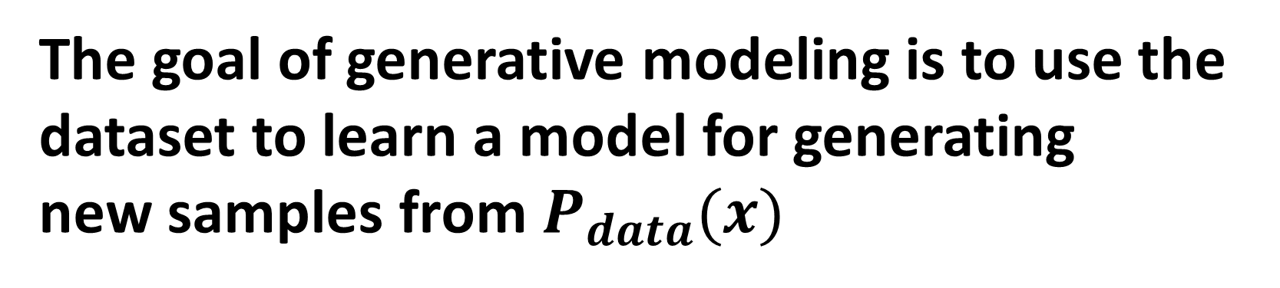
The goal of generative modeling is to use the dataset to learn a model for generating
new samples from $P_{data}(x)$
Sure enough, as the models get bigger and bigger, they begin to deliver human-level, and then superhuman results.
https://www.sequoiacap.com/article/generative-ai-a-creative-new-world/

Slide 4
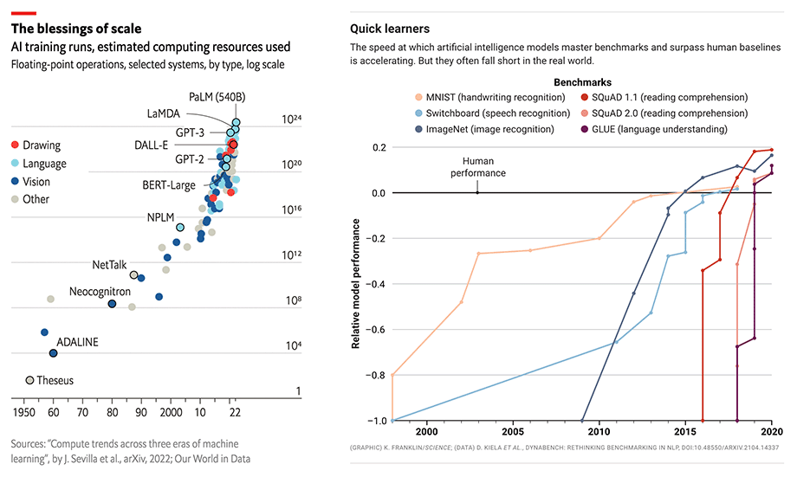
SEQUOIA

Slide 5
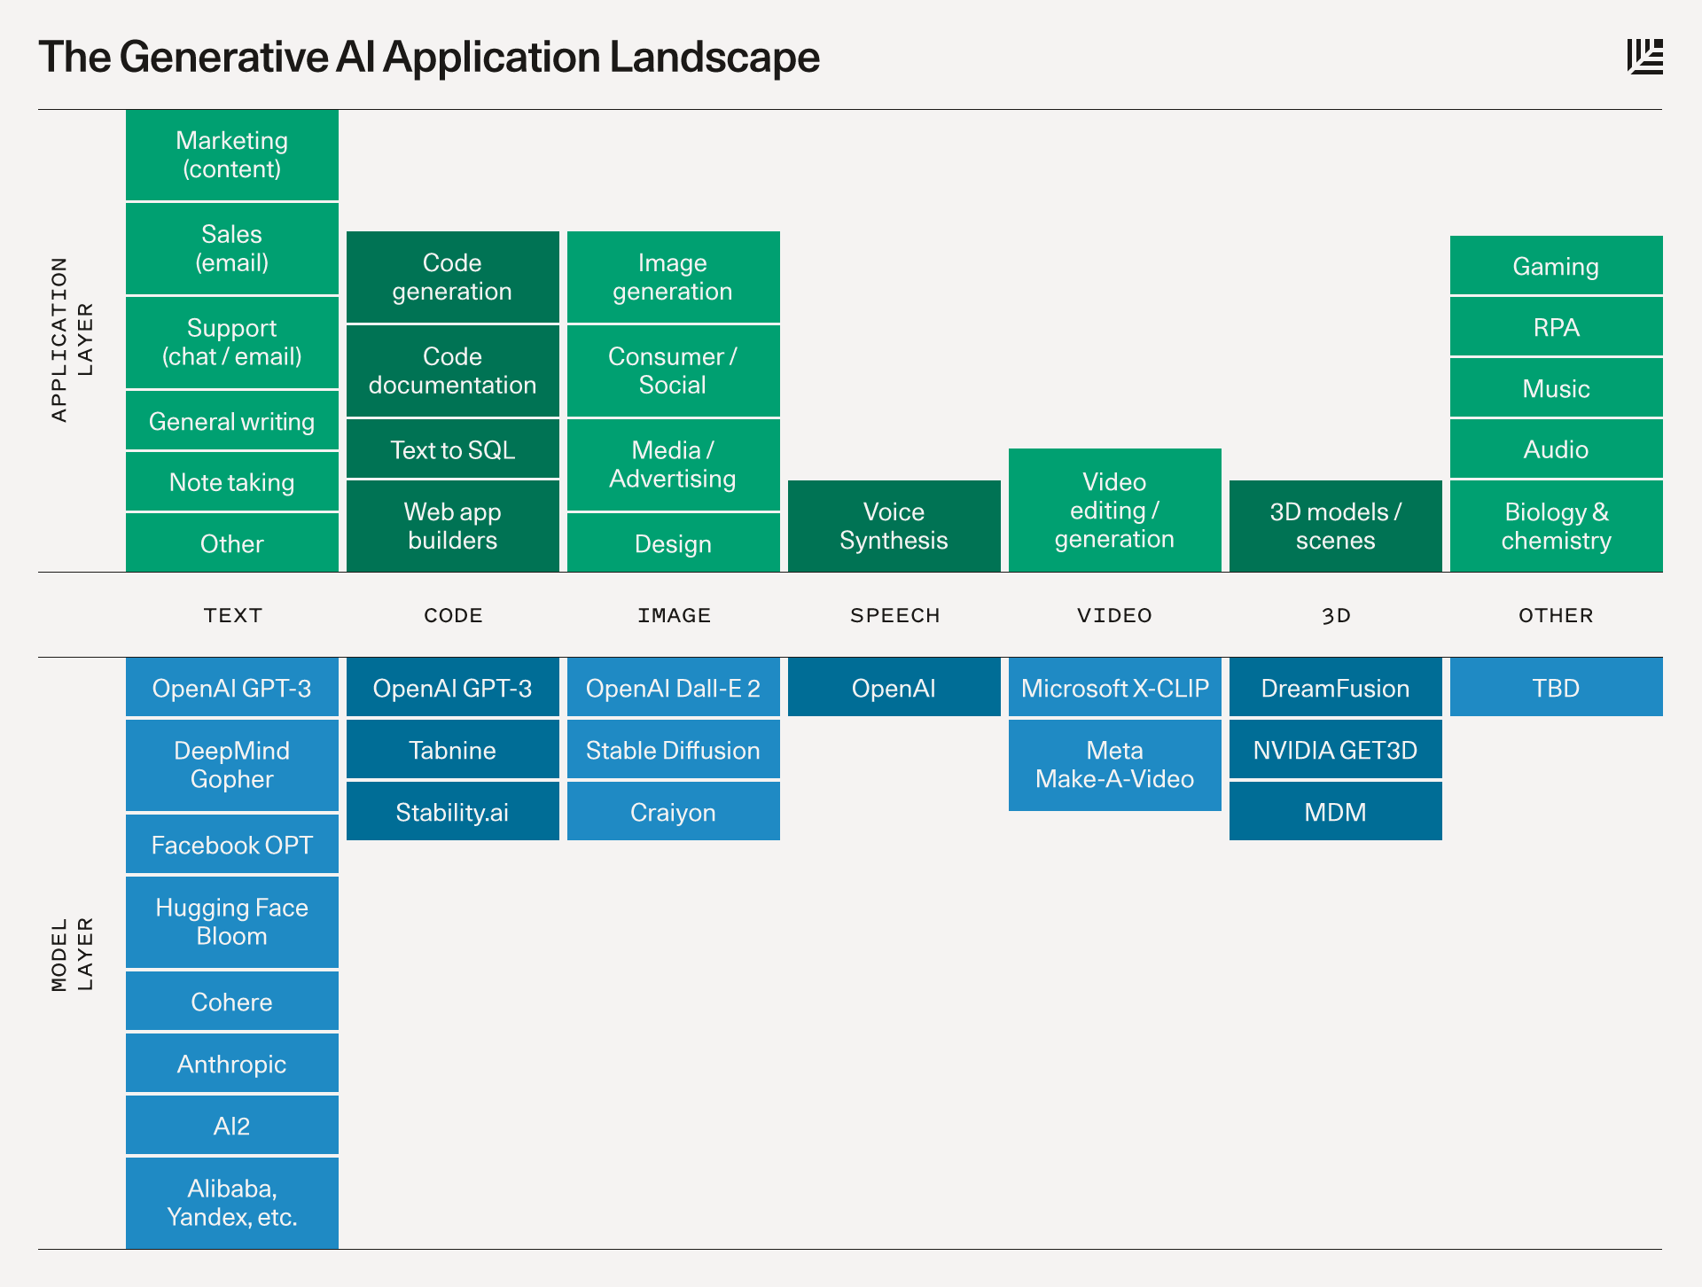
SEQUOIA

Slide 6

1.4. Generative Models
1.4.1. Introduction
Analytic AI: analyze a set of data and find patterns in it.
Generative AI: Use existing content like
text, audio files, or images to create
new plausible content.
The MIT Technology review described
generative AI as one of the most
promising advances in the world of AI
in the past decade
Generative AI is well on the way to becoming not just faster and cheaper, but better in some cases than what humans create by hand (SEQUOIA)
IBM developer blog. What is generative AI and how much power does it have

Slide 7

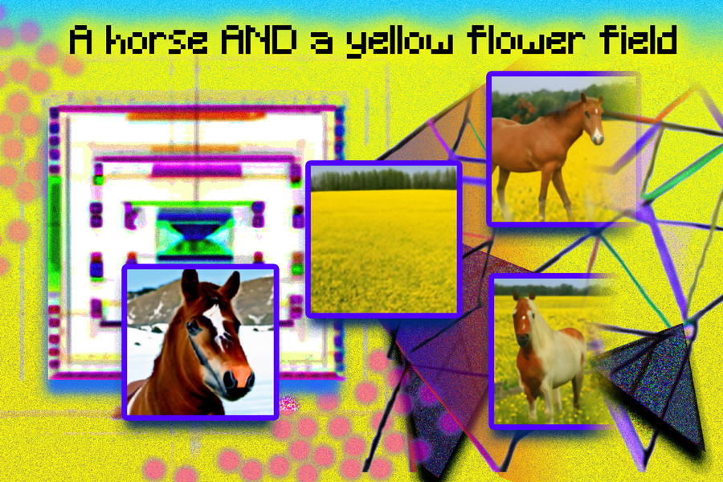
MIT AI and ML
Deep Generative Models
This course introduces how to develop deep generative models (DGMs) by integrating probabilistic graphical models and deep learning to generate realistic data including images, texts, graphs, etc. Course contents include 1) basics of probabilistic graphical models, including Bayesian network and Markov random field; 2) posterior inference methods, including message passing, variational inference, and Markov chain Monte Carlo sampling; 3) parameter learning and structure learning methods, including maximum likelihood estimation, expectation–maximization algorithm, and graphical LASSO; 4) deep generative models (DGMs), including variational auto-encoder, generative adversarial networks, normalizing flows, and evaluation of DGMs; 5) applications of DGMs in image generation, text generation, and graph generation.
https://www.csail.mit.edu/

Slide 8
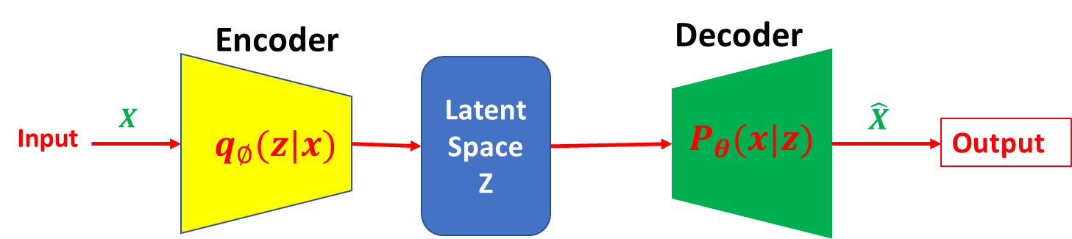
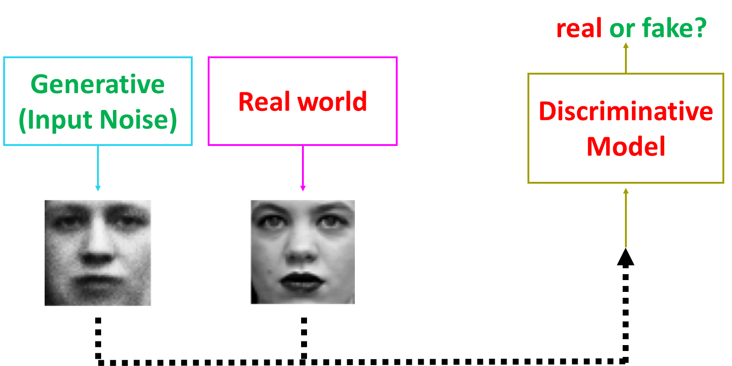
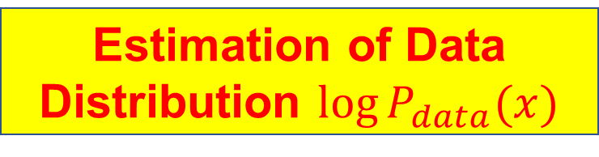
1.4.2. Stages of Generative Models
Basic Ideas:
Estimation of Data Distribution $\log{P_{data}(x)}$
Sampling from Estimated Data Distribution
Data
Early Stage
VAE
GAN

Slide 9
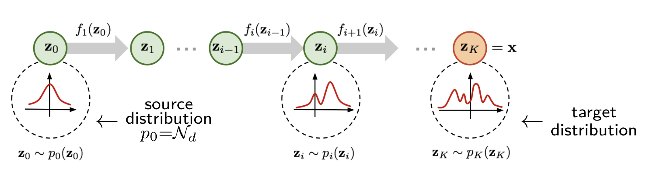
Normalizing Flows
Kingma and Welling, 2014; Auto-Encoding Variational Bayes
Goodfellow et al. 2014; Generative Adversarial Nets
Rezende 2016, Variational inference with normalizing flows.
Xiong MM (2022) Artificial Intelligence and Causal Inference. CRC Press

Slide 10
1.4.2. Stages of Generative Models
Current Stage
Score Matching
Denoise Diffusion Probability Models
Stochastic Differential Equations

Slide 11
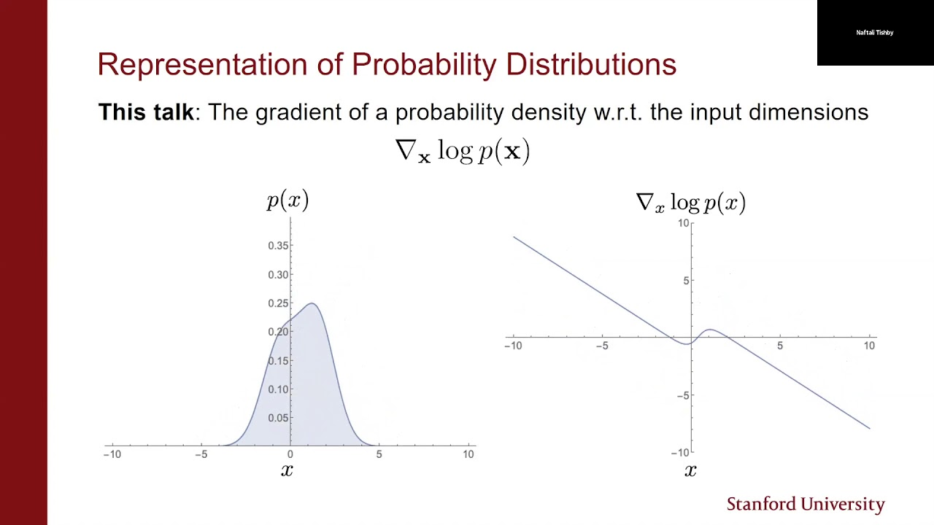
1.4.3. Score Match
1.4.3.1. Optimal Score
Let $L\left(x,θ\right)$ be a likelihood function. The score function is defined as
$U\left(θ\right)=\frac{∂\log{L(x,θ)}}{∂θ}$.
Define Scores in Diffusion Models:
Consider i.i.d. samples $\left\{x_{1}, …, x_{n}\right\}, x_{i}∈R^{d}$.
Unnormalized distribution for model:${\tilde{P}}_{m}(x, θ)$
Normalized distribution for model: $P_{m }\left(x,θ\right),P_{m }\left(x,θ\right)=\frac{{\tilde{P}}_{m}(x, θ)}{Z(θ)}. Z\left(θ\right)=\int{{\tilde{P}}_{m}\left(x, θ\right)dx}$
Score for Data: ${ S}_{data}\left(x\right)=∇_{x}\log{P_{data}(x)}$
Score for Model: $S_{m}\left(x,θ\right)=∇_{x}\log{P_{m}\left(x,θ\right)=∇_{x}\log{{\tilde{P}}_{m}(x,θ)}}$
Song et al. 2019, Sliced Score Matching: A Scalable Approach to Density and Score Estimation

Slide 12
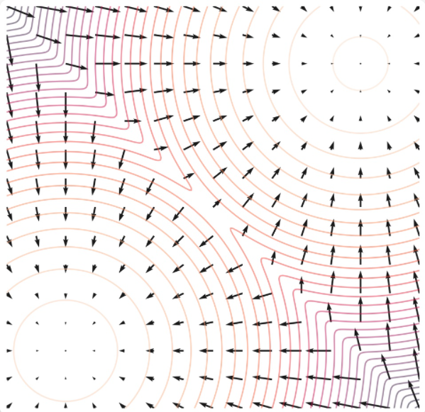

Slide 13
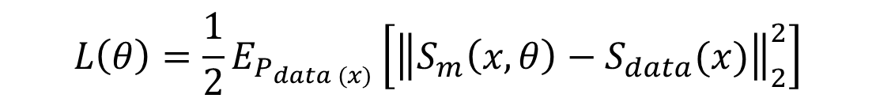
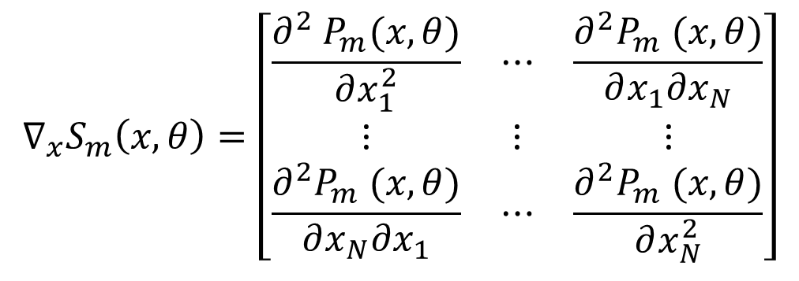
1.4.3.2. Fisher Divergence and Score Matching
Fisher Divergence between $P_{data}\left(x\right) and P_{m}(x,θ)$ :
$$L\left(θ\right)=\frac{1}{2}E_{P_{data (x)}}\left[{\left\|S_{m}\left(x, θ\right)−S_{data}(x)\right\|}_{2}^{2}\right]$$
Fisher divergence is equal to zero, if and only if two densities are equal.
Since we only have samples and do not have access to the score function of the data $S_{data}(x$), we cannot compute the Fisher divergence.
However, the Fisher divergence can be transformed to
$J\left(θ\right)=E_{p_{data(x)}}\left[Tr\left(∇_{x}S_{m}\left(x,θ\right)\right)+\frac{1}{2}{\left\|S_{m}(x,θ)\right\|}_{2}^{2}\right],$Tr denotes trace of matrix.,
$$∇_{x}S_{m}\left(x,θ\right)=\left[\begin{matrix}\frac{∂^{2} P_{m}(x,θ)}{∂x_{1}^{2}} & ⋯ & \frac{∂^{2}P_{m} (x,θ)}{∂x_{1}∂x_{N}} \\ ⋮ & ⋮ & ⋮ \\ \frac{∂^{2}P_{m} (x,θ)}{∂x_{N}∂x_{1}} & ⋯ & \frac{∂^{2}P_{m} (x,θ)}{∂x_{N}^{2}}\end{matrix}\right]$$
Is the Hessian of the log-density
function of model.

Slide 14

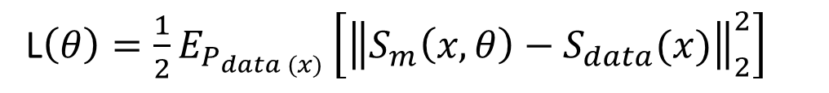
Sampling Formula for Computing Fisher Divergence:
$J\left(θ, x_{1}, …, x_{N}\right)=\frac{1}{N}\sum_{i=1}^{N}{\left[Tr\left(∇_{x}S_{m}\left(x_{i}, θ\right)\right)+\frac{1}{2}{\left\|S_{m}(x_{i}, θ)\right\|}_{2}^{2}\right]}$
Proof
L$\left(θ\right)=\frac{1}{2}E_{P_{data (x)}}\left[{\left\|S_{m}\left(x, θ\right)−S_{data}(x)\right\|}_{2}^{2}\right]$
$$=\frac{1}{2}E_{P_{data (x)}}\left[S_{data}^{T}\left(x\right)S_{data}\left(x\right)+S_{m}^{T}\left(x,θ\right)S_{m}\left(x,θ\right)−2S_{m}^{T}\left(x,θ\right)S_{data}\left(x\right)\right]$$
Since the first term does not depend on the parameter $θ$, we only need to consider the second and third terms in the above equation.
$${\frac{1}{2}E_{P_{data (x)}}[S}_{m}^{T}\left(x,θ\right)S_{m}\left(x,θ\right)]=\frac{1}{2}\sum_{i=1}^{n}{E_{P_{data (x)}}{[\left(S_{m}(x_{i},θ\right)}^{2}]}$$
$${\frac{1}{2}E_{P_{data (x)}}[2S}_{m}^{T}\left(x,θ\right)S_{data}\left(x\right)]=\sum_{i=1}^{n}{\int{P_{data}\left(x\right)}S_{m}}(x_{i},θ)\frac{∂\log{P_{data}(x_{i})}}{∂x_{i}}$$
$$=\sum_{i=1}^{n}{\int{S_{m}(x_{i},θ)\frac{∂P_{data}(x_{i})}{∂x_{i}}}dx_{i}}$$

Slide 15





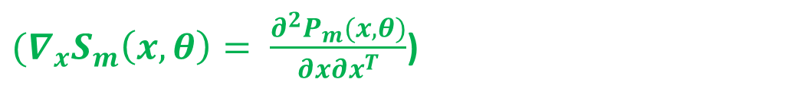
$$=0$$
$$=\sum_{i=1}^{n}{\left[{P_{data}\left(x_{i}\right)S_{m}\left(x_{i},θ\right)|}_{−∞}^{∞}−\int{P_{data}(x_{i})\frac{∂S_{m}(x_{i},θ)}{∂x_{i}}dx_{i}}\right]}$$
$$=−\sum_{i=1}^{n}{E_{P_{data}}(x_{i})\frac{∂^{2}\log{P_{m}(x_{i},θ)}}{∂x_{i}^{2}}}$$
${(∇}_{x}S_{m}\left(x,θ\right)= \frac{∂^{2}P_{m}(x,θ)}{∂x∂x^{T}}$)
$$=−E_{P_{data}(x)}\left[Tr\left(∇_{x}S_{m}\left(x,θ\right)\right)\right]$$
$$Tr\left(A\right)=a_{11}+…+a_{kk}$$
which implies
$$J\left(θ\right)=E_{p_{data(x)}}\left[Tr\left(∇_{x}S_{m}\left(x,θ\right)\right)+\frac{1}{2}{\left\|S_{m}(x,θ)\right\|}_{2}^{2}\right]$$

Slide 16

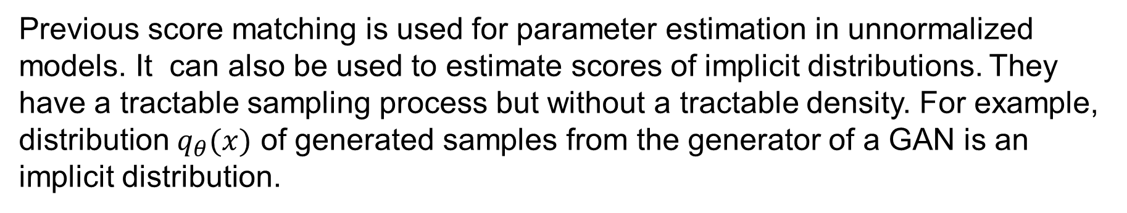
1.4.3.3. Score Estimation for Implicit Distribution
Motivation
Previous score matching is used for parameter estimation in unnormalized models. It can also be used to estimate scores of implicit distributions. They have a tractable sampling process but without a tractable density. For example, distribution $q_{θ}(x)$ of generated samples from the generator of a GAN is an implicit distribution.
Sometimes, we need to estimate the score function $S_{q}\left(x\right)=∇_{x}\log{q_{θ}\left(x\right). }$For example, optimizing the entropy $H\left(q_{θ}\left(x\right)\right),$ we need to calculate score $S_{q}\left(x\right).$
Let $x\sim q_{θ}\left(x\right), x=g_{θ}\left(ε\right), ε\sim N\left(0,I\right), g_{θ}$ is a deterministic function. Then,
$$q_{θ}\left(x\right)=P_{θ}(ε){\left|∇_{ε}(g_{θ}\left(ε\right))\right|}^{−1}$$
$$∇_{θ}H\left(q_{θ}\right)=−∇_{θ}\left\{E_{q_{θ}\left(x\right)}\left[\log{q_{θ}\left(x\right)}\right]\right\}=−∇_{θ}\left\{E_{p(ε)}\left[\log{q_{θ}(g_{θ}\left(ε\right))}\right]\right\}$$
$$=−E_{p(ε)}\left[{\left.∇_{x}\log{q_{θ}\left(x\right)}\right|}_{x=g_{θ}\left(ε\right)}∇_{θ}g_{θ}(ε)\right]$$

Slide 17
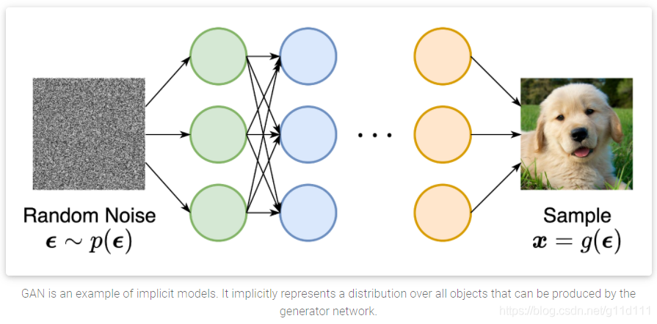

Slide 18



1.4.3.4. Score Estimation
$∇_{x}\log{q_{θ}\left(x\right)}$ is intractable, but can be approximated by score function.
Score function:$h\left(x,θ\right):$ a neural network
$$x$$
$$h(x,θ)$$
$L\left(θ, P_{data}\left(x\right)\right)=\frac{1}{2}E_{P_{data}(x)}\left[{\left\|h\left(x,θ\right)−∇_{x}\log{q_{θ}\left(x\right)}\right\|}_{2}^{2}\right]$
$$L\left(θ, P_{data}\left(x\right)\right)=0 ↔h\left(x,θ\right)=∇_{x}\log{q_{θ}\left(x\right)}$$

Slide 19
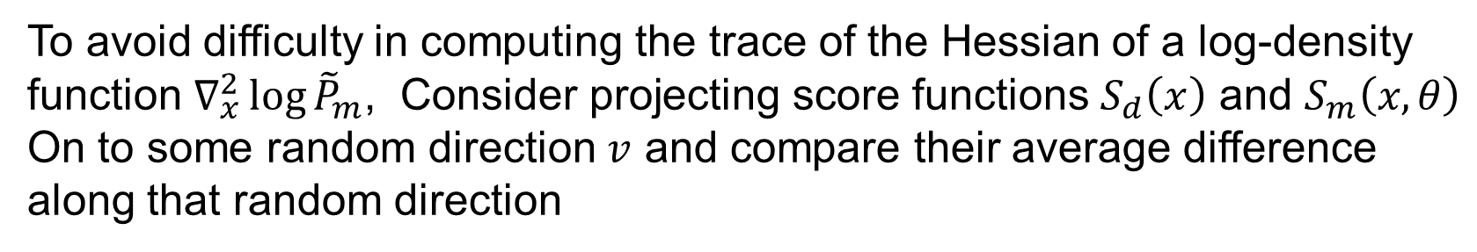
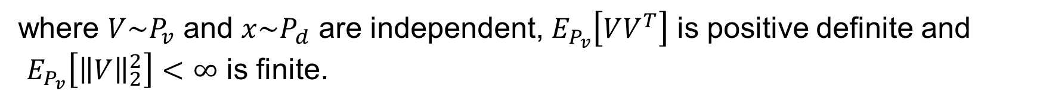
1.4.3.5. Sliced Score Matching
Motivation
To avoid difficulty in computing the trace of the Hessian of a log-density function $∇_{x}^{2}\log{{\tilde{P}}_{m}}$, Consider projecting score functions $S_{d}\left(x\right)$ and $S_{m}\left(x, θ\right)$
On to some random direction $v$ and compare their average difference along that random direction
Objective Function for Sliced Score Matching
$$L\left(θ, P_{v}\right)=\frac{1}{2}E_{P_{v}}E_{P_{d}}\left[{\left(V^{T}S_{m}\left(x,θ\right)−V^{T}S_{d}(x)\right)}^{2}\right]$$
(4.1)
where $V\sim P_{v}$ and $x\sim P_{d}$ are independent, $E_{P_{v}}\left[VV^{T}\right]$ is positive definite and
$E_{P_{v}}\left[{\left\|V\right\|}_{2}^{2}\right]<∞$ is finite.
Reduction
To eliminate the dependence of $L(θ, P_{v})$ on $S_{d},L\left(θ, P_{v}\right)$ can be reduced to
$$L\left(θ, P_{v}\right)=J\left(θ, P_{v}\right)+C$$
(4.2)
where $J\left(θ, P_{v}\right)= E_{P_{v}}E_{P_{d}}[V^{T}∇_{x}S_{m}\left(x,θ\right)V+\frac{1}{2}{\left(V^{T}S_{m}\left(x,θ\right)\right)}^{2}]$, $C$ is a constant.

Slide 20
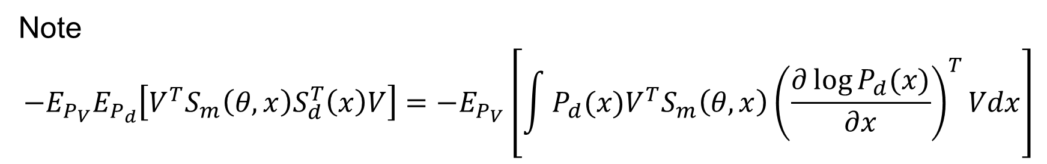


Proof
Let $C=\frac{1}{2}E_{P_{V}}E_{P_{d}}\left[{\left(V^{T}S_{d}(x)\right)}^{2}\right]$
(4.3)
Note
$$−E_{P_{V}}E_{P_{d}}\left[V^{T}S_{m}\left(θ,x\right)S_{d}^{T}\left(x\right)V\right]={−E}_{P_{V}}\left[\int{P_{d}(x)V^{T}S_{m}\left(θ,x\right){\left(\frac{∂\log{P_{d}(x)}}{∂x}\right)}^{T}Vdx}\right]$$
$$=0$$
$=$ $E_{P_{V}}\left[−{\left.V^{T}S_{m}\left(θ,x\right)P_{d}^{T}\left(x\right)V\right\rfloor }_{−∞}^{∞}+\int{V^{T}∇_{x}S_{m}(x)P_{d}^{T}\left(x\right)Vdx}\right]$ (part by integration)
$$=E_{P_{V}}E_{P_{d}}\left\lceil V^{T}∇_{x}S_{m}\left(x\right)V\right\rceil$$
(4.4)
Substituting equations (4.3) and (4.4) into equatiom (4.1) yields equation (4.2).

Slide 21
1.4.3.6. Sampling Formula of Sliced Score
$$,$$
Let $X_{1}^{N}=\left\{x_{1},…, x_{N}\right\}$and $V_{11}^{NM}={\left\{V_{ij}\right\}}_{1≤i≤N, 1≤j≤M}$
Define Sampling Formula of $J\left(θ, P_{v}\right)$:
$$\hat{J}\left(θ, X_{1}^{NN}, V_{11}^{NM}\right)=\frac{1}{N}\frac{1}{M}\sum_{i−1}^{N}{\sum_{j=1}^{M}{\left[V_{ij}^{T}∇_{x}S_{m}\left(x_{i}, θ\right)V_{ij}+\frac{1}{2}{\left(V_{j}^{T}S_{m}(x_{i}, θ)\right)}^{2}\right]}}$$
(4.5)

Slide 22

1.4.3.7. Estimator with Reduced Variance
Assume that $V\sim N\left(0,I\right).$Then,
$${ E}_{P_{V}}\left[VV^{T}\right]=I$$
$$E_{P_{V}}\left[{\left(V^{T}S_{m}(x,θ)\right)}^{2}\right]=E_{P_{V}}\left[Tr\left({\left(V^{T}S_{m}(x,θ)\right)}^{2}\right)\right]$$
$$=E_{P_{V}}\left[Tr\left(\left(V^{T}S_{m}(x,θ\right){S_{m}(x,θ)}^{T}V\right)\right]$$
$$=E_{P_{V}}\left[{Tr(S}_{m}(x,θ){S_{m}\left(x,θ\right)}^{T}VV^{T})\right]$$
$={Tr(S}_{m}(x,θ){S_{m}\left(x,θ\right)}^{T}$ $E_{P_{V}}\left[VV^{T}\right]$)
$$={Tr(S}_{m}(x,θ){S_{m}\left(x,θ\right)}^{T})={\left\|S_{m}\left(x,θ\right)\right\|}_{2}^{2}$$
(4.6)
Substituting equation (4.6) into equation (4.2) yields
$$J_{vr}\left(θ, P_{v}\right)= E_{P_{v}}E_{P_{d}} \left[V^{T}∇_{x}S_{m}\left(x,θ\right)V+\frac{1 }{2}{\left\|S_{m}\left(x,θ\right)\right\|}_{2}^{2}\right]$$
(4.7)

Slide 23
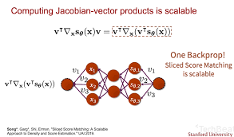
$${\hat{J}}_{vr}\left(θ, X_{1}^{NN}, V_{11}^{NM}\right)=\frac{1}{N}\frac{1}{M}\sum_{i−1}^{N}{\sum_{j=1}^{M}{\left[V_{ij}^{T}∇_{x}S_{m}\left(x_{i}, θ\right)V_{ij}+\frac{1}{2}{\left\|S_{m}\left(x_{i}, θ\right)\right\|}_{2}^{2}\right]}}$$
(4.8)
Song et al. 2019, Sliced Score Matching: A Scalable Approach to Density and Score Estimation

Slide 24




1.4.3.8. Algorithm for Sliced Score Matching
Step 1: Input ${\tilde{P}}_{m}\left(.;θ\right), x, V$
Step 2: $S_{m}(x;θ)←∇_{x}\log{{\tilde{P}}_{m}(x,θ)}$
Step 3: $V^{T}∇_{x}S_{m}(x,θ)←∇_{x}\left(V^{T}S_{m}(x,θ)\right)$
Step 4: $J←\frac{1}{2}{\left(V^{T}S_{m}(x,θ)\right)}^{2}$ (or $\frac{1 }{2}{\left\|S_{m}\left(x,θ\right)\right\|}_{2}^{2})$
Step 5: $J←J+V^{T}∇_{x}S_{m}\left(x,θ\right)V$
Step 6: Output $J$

Slide 25
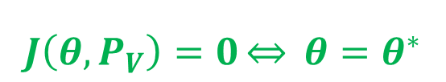
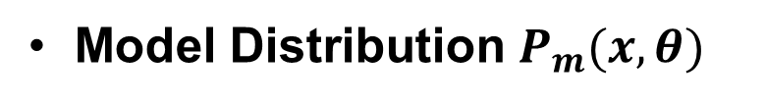



1.4.3.9. Consistency of Estimator
Data Distribution $P_{d}(x)$
Model Distribution $P_{m}(x,θ)$
$$J\left(θ,P_{V}\right)=0\underset{⇔}{} θ=θ^{∗}$$
$$P_{m}\left(x,θ^{∗}\right)=P_{d}(x)$$
Let
$${\hat{θ}}_{N.M}→θ$$
$${\hat{θ}}_{N,M}=\underset{θ}{argmin}{\hat{J}(θ, X_{1}^{N}, V_{11}^{N})}$$
Then, for a fixed $M,$under some regular conditions
$${\hat{θ}}_{N,M}\underset{→}{p}θ^{∗}, N→∞$$

Slide 26
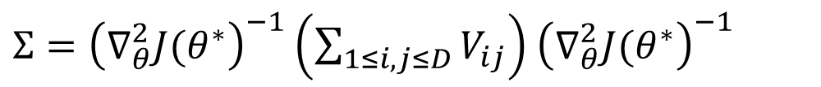
1.4.3.10. Asymptotic Normality
Under some assumptions, we have
$$\sqrt{N}({\hat{θ}}_{N,m}−θ^{∗})\underset{→}{d}N(0, Σ)$$
where
$Σ={\left(∇_{θ}^{2}J(θ^{∗}\right)}^{−1}\left(\sum_{1≤i,j≤D}{V_{ij}}\right)$ ${\left(∇_{θ}^{2}J(θ^{∗}\right)}^{−1}$

Slide 27
